Slide 1


Slide 2
EMOTIONS
ANGER
DISGUST
FEAR
HAPPINESS
SADNESS, AND
SURPRISE

Slide 3
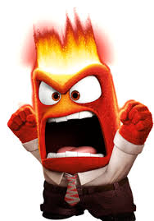


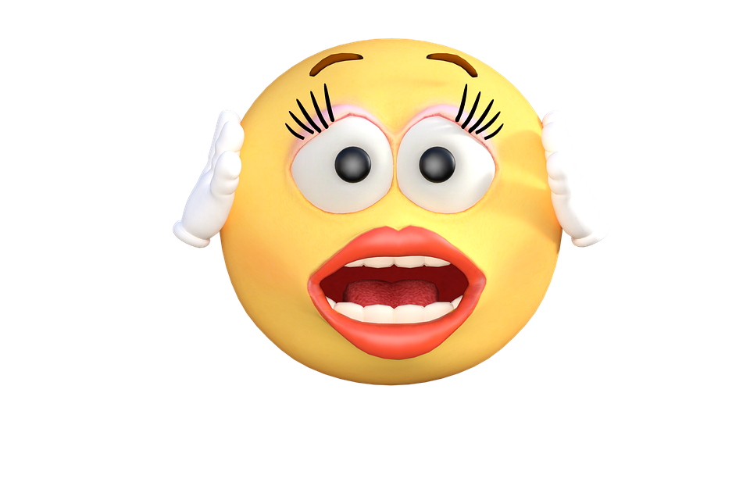
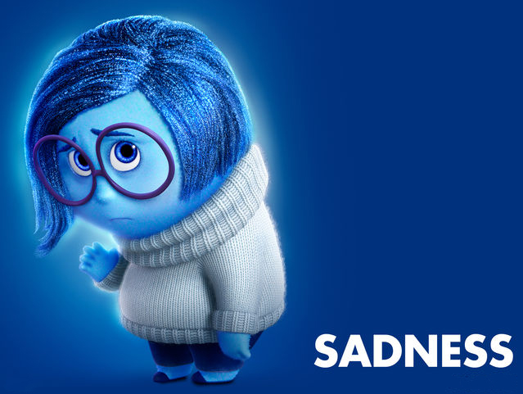
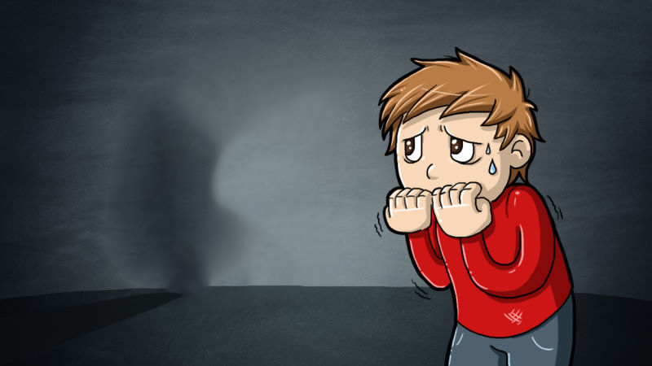
Emotions

Slide 4

Emotional intelligence
The capacity to be aware of, control, and express one's emotions, and to handle interpersonal relationships judiciously and empathetically.
”Emotional intelligence is the key to both personal and professional success"
Daniel Goleman 2011

Slide 5
Emotional Intelligence
Is learnable
Emotional intelligence cab be developed over time
It improves with age

Slide 6
How EQ develops
Nature
1. Greater social competence
EQ
2. High quality performance
Nurture
3. Better health

Slide 7
5 domains of emotional intelligence
Interpersonal
Empathy
Managing Relationship
Intrapersonal
Self Awareness
Self Management
Self Motivation

Slide 8
Emotional Intelligence: From Theory to Practice

Slide 9
Self - perception

Slide 10
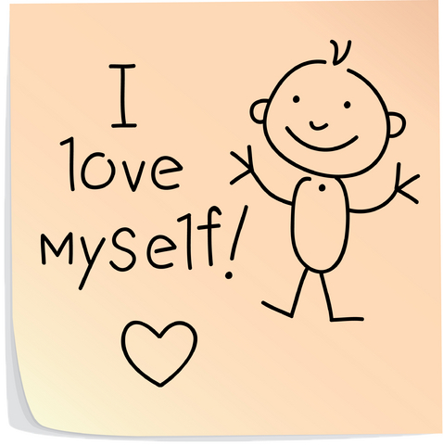

Self – Regard
Self – Regard is respecting oneself while understanding and accepting one’s strengths and weakness.
Self – Regard is often associated with feelings of inner strength and self confidence.

Slide 11

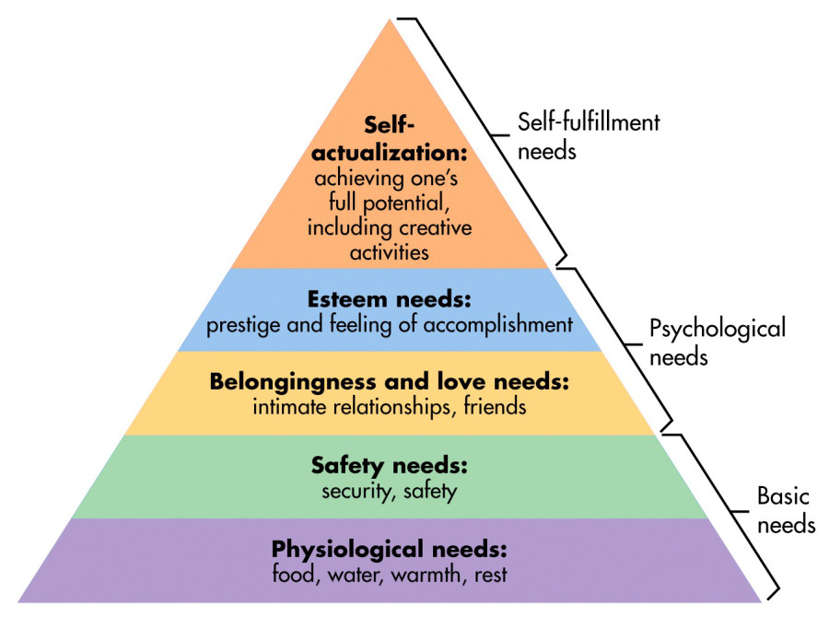
Self – Actualisation
Self – Actualisation is the willingness to persistently try to improve oneself and engage in the pursuit of personally relevant and meaningful objectives that lead to a rich and enjoyable life.

Slide 12
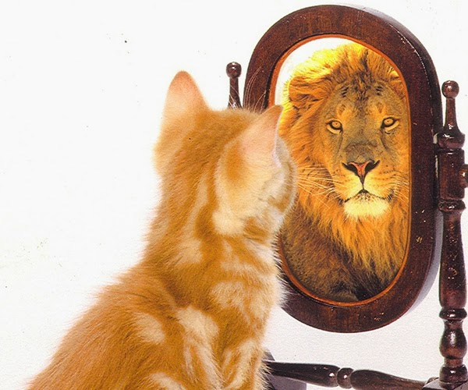
Emotional self awareness
Emotional self awareness includes recognising and understanding one’s own emotions. This includes the ability to differentiate between subtleties in one’s own emotions while understanding the cause of these emotions and the impact they have on one’s thoughts and actions and those of others.

Slide 13
Self -expression

Slide 14
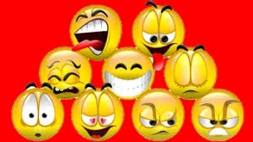
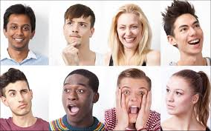
Emotional Expression
Emotional Expression is openly expressing one’s feelings verbally and non verbally.

Slide 15

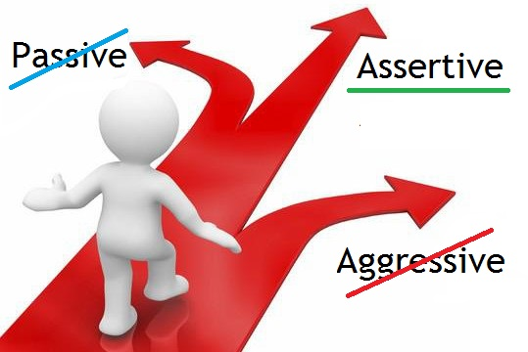
Assertiveness
Assertiveness involves communicating feelings, beliefs and thoughts openly and defending personal rights and values in a socially acceptable, non offensive and non destructive manner.

Slide 16

Independence
Independence is the ability to be self directed and free from emotional dependency on others. Decision making, planning and daily tasks are completed autonomously.

Slide 17
Stress management

Slide 18


Flexibility
Flexibility is adapting emotions, thoughts and behaviours to unfamiliar, unpredictable and dynamic circumstances or ideas.

Slide 19

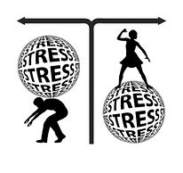
Stress Tolerance
Stress Tolerance – involves coping with stressful or difficult situations and believing that one can manage or influence situations in a positive manner.

Slide 20


Optimism
Optimism is an indicator of one’s positive attitude and outlook on life. It involves remaining hopeful and resilient, despite occasional setbacks.

Slide 21
Decision making

Slide 22

Problem Solving
Problem Solving is the ability to find solutions to problems in situations where emotions are involved Problem solving includes the ability to understand how emotions impact decision making.

Slide 23

Reality Testing
Reality Testing is the capacity to remain objective by seeing things as they really are. This capacity involves recognising when emotions or personal bias can cause one to be less objective.

Slide 24
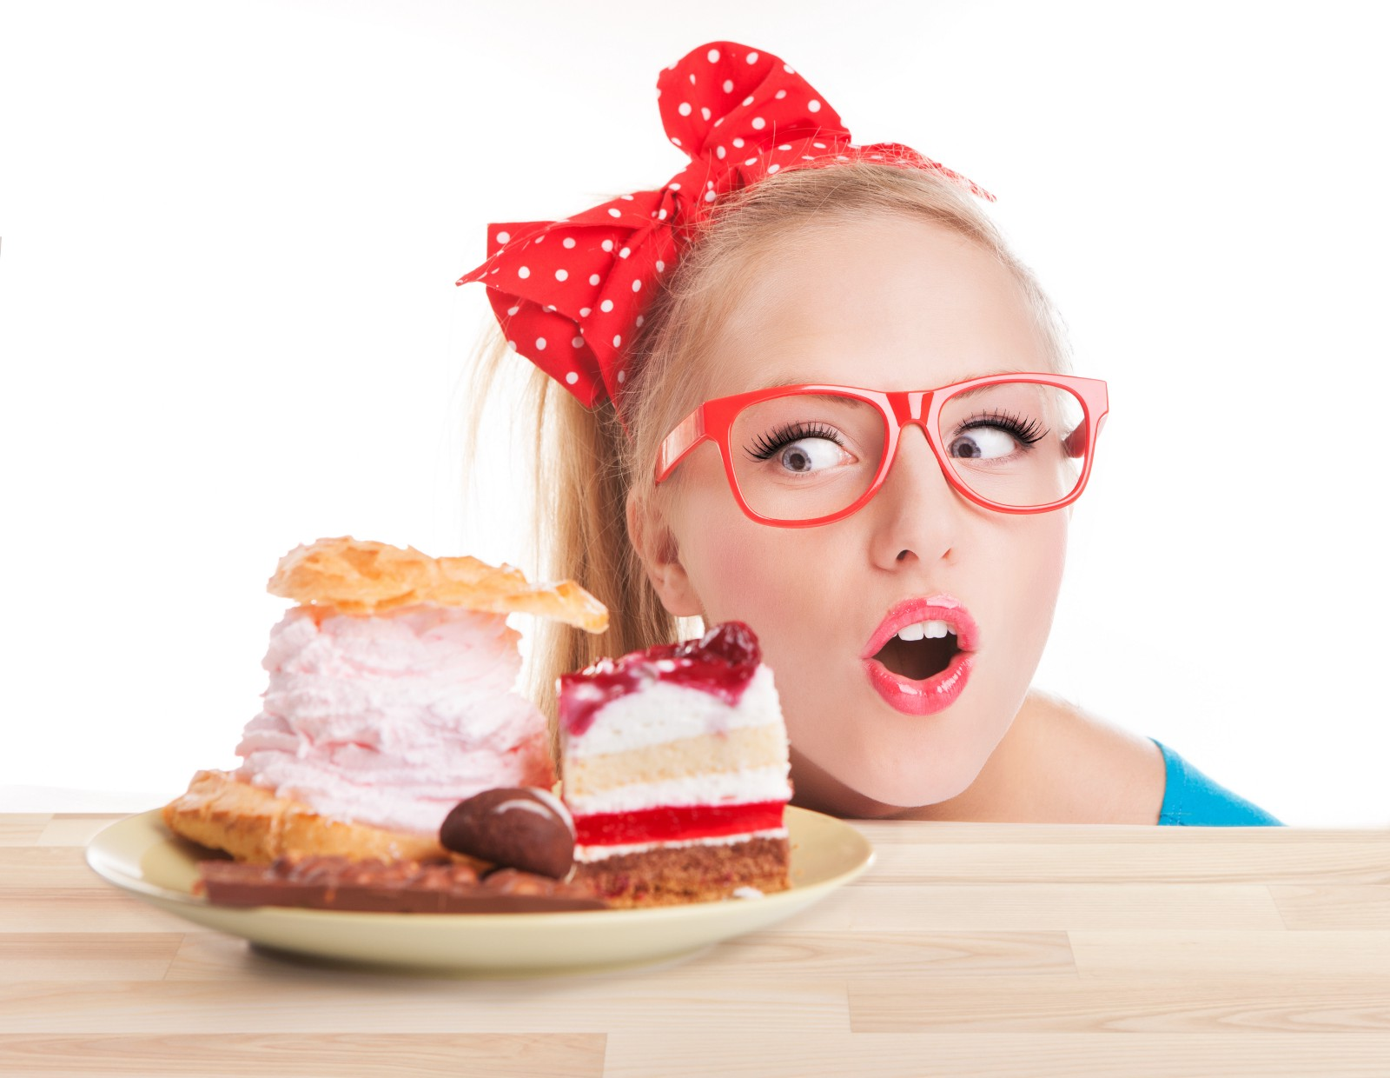
Impulse control
Impulse control is the ability to resist or delay an impulse, drive or temptation to act and involves avoiding rash behaviours and decision making.

Slide 25
Interpersonal

Slide 26

Interpersonal Relationships
Interpersonal Relationships – refers to the skill of developing and maintaining mutually satisfying relationships that are characterised by trust and compassion.

Slide 27
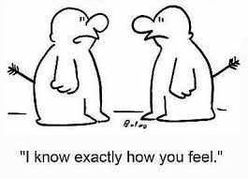

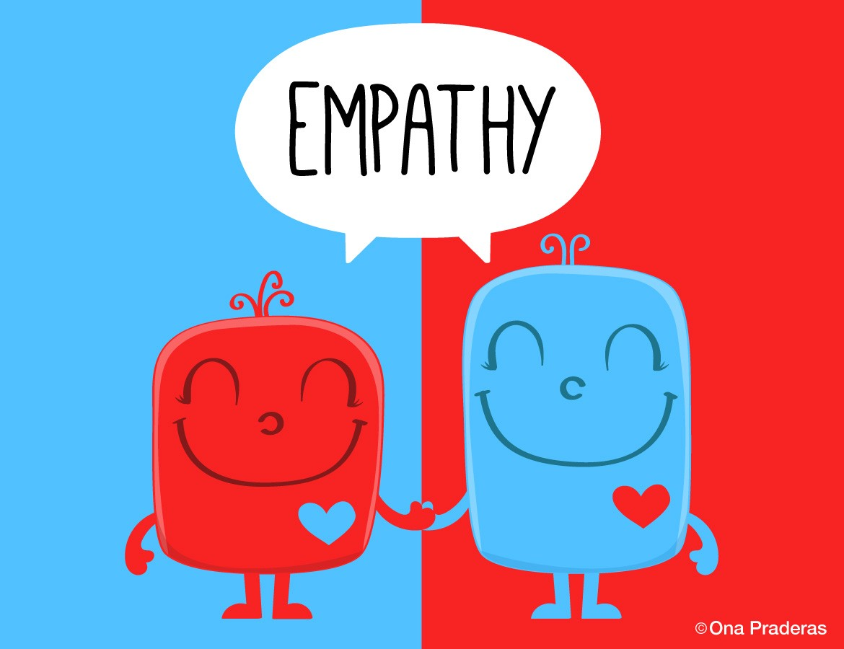
Empathy
Empathy is recognizing, understanding and appreciating how other people feel. Empathy involves being able to articulate your understanding of another perspective and behaving in a way that respect others’ feelings.

Slide 28

Social responsibility
Social responsibility is willingly contributing to society, to ones’ social groups and generally to the welfare of others. Social Responsibility involves acting responsibly, having social consciousness and showing concern for the greater community.

Slide 29
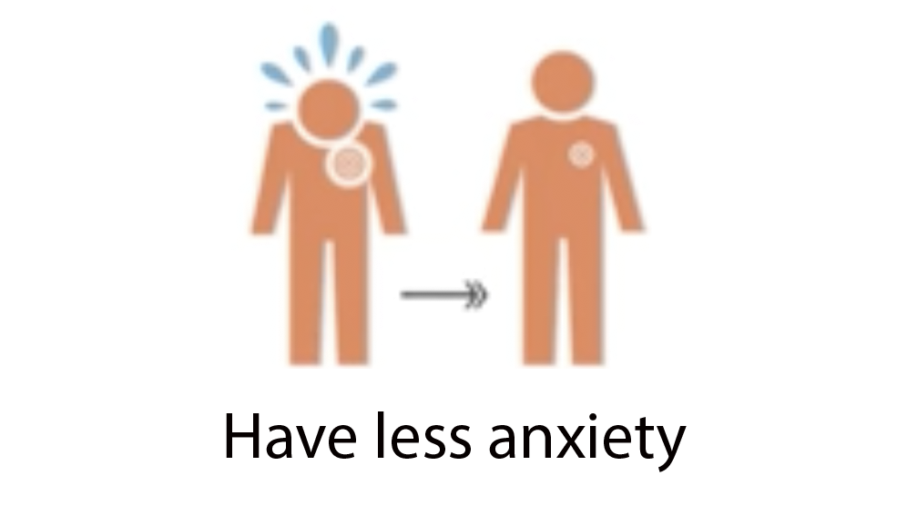
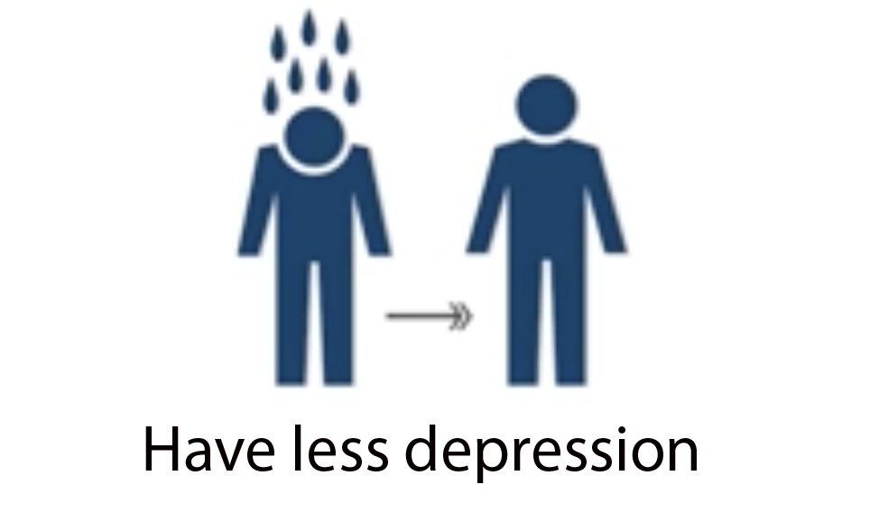
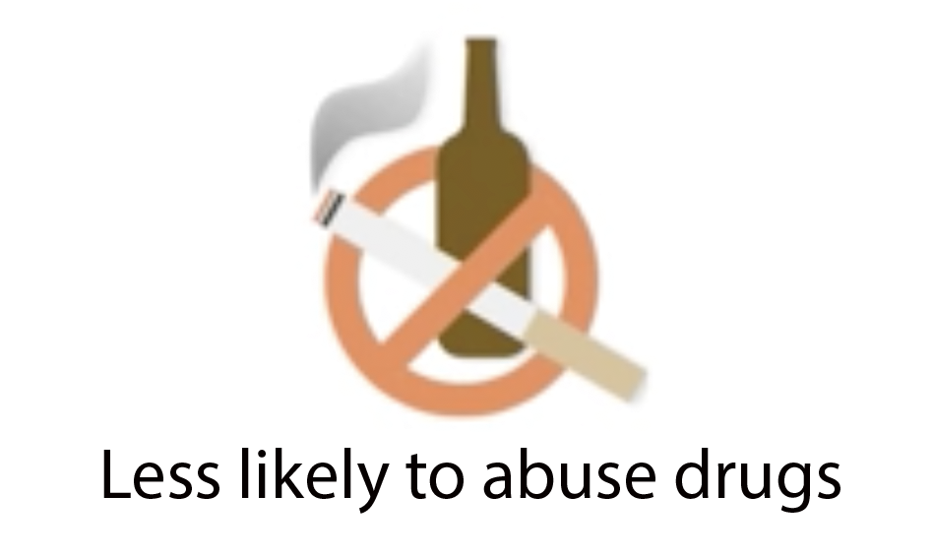
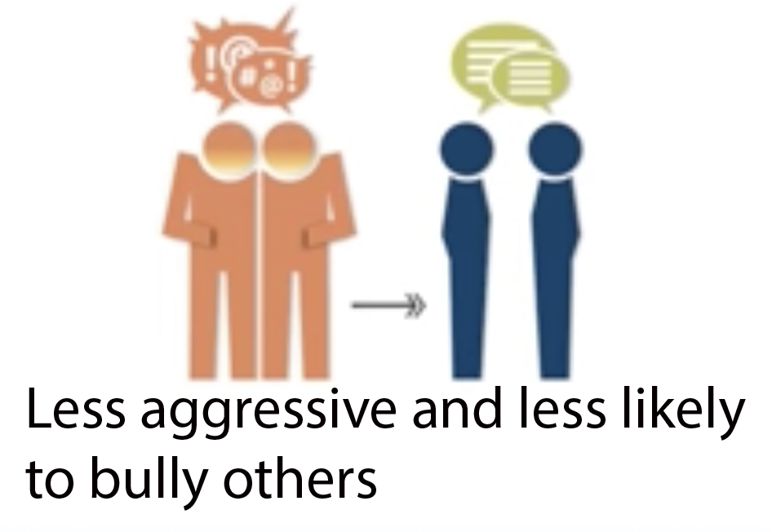
Students with high EQ……

Slide 30
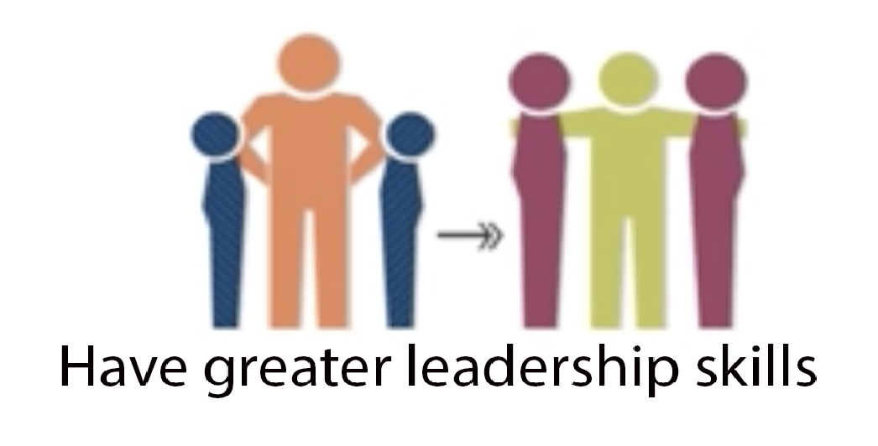
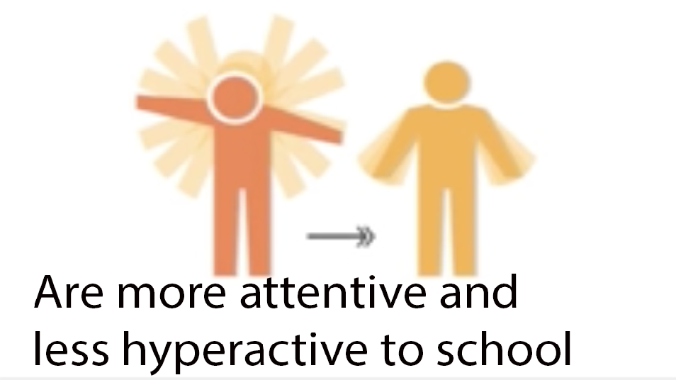
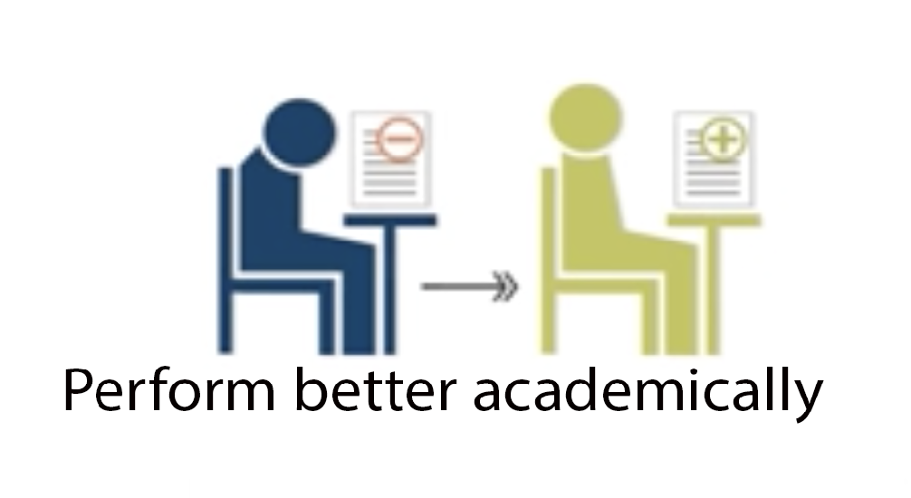
Students with high EQ……….

Slide 31
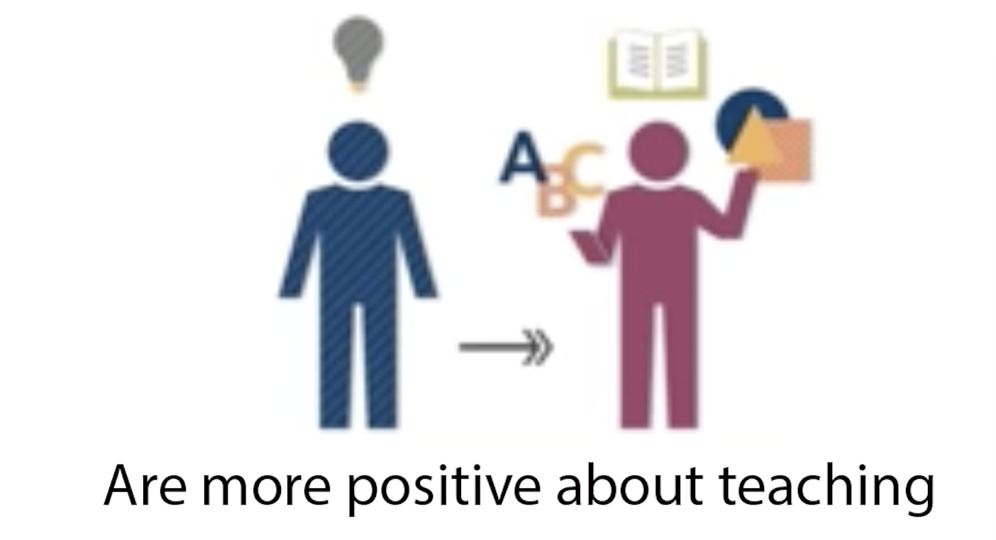
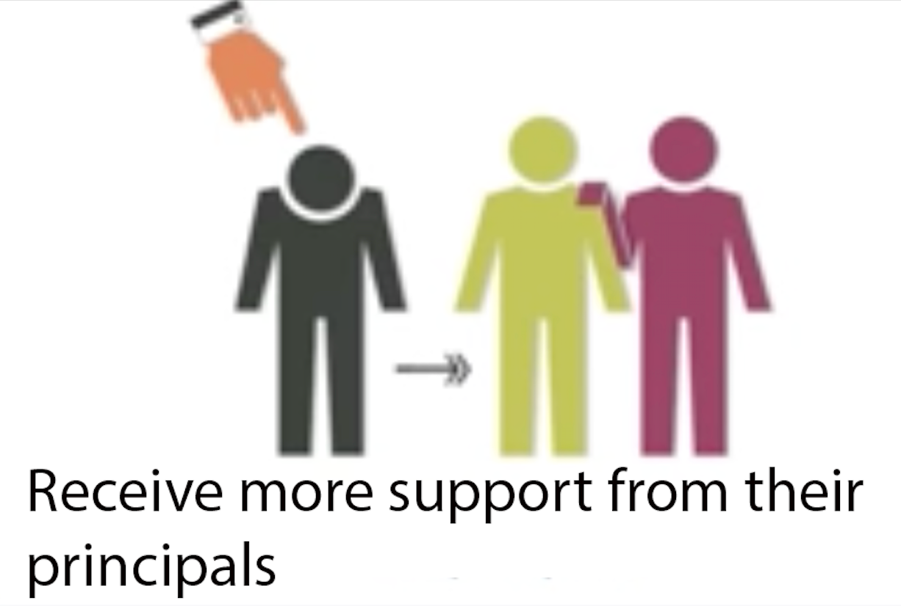
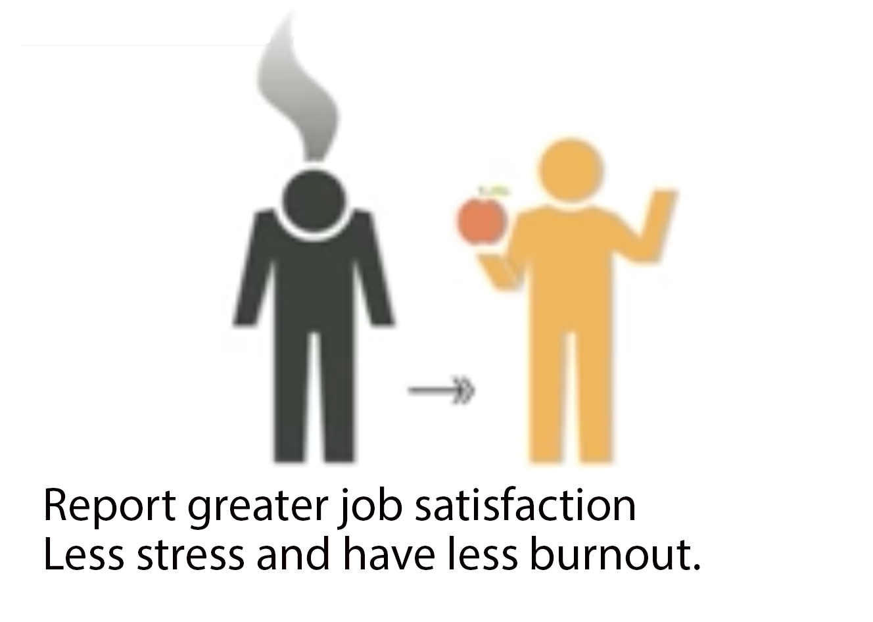
Teachers…….

Slide 32
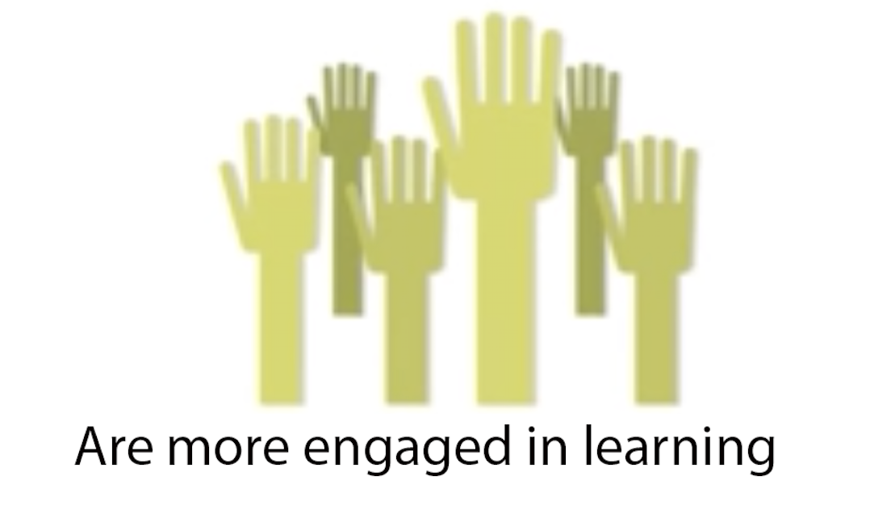
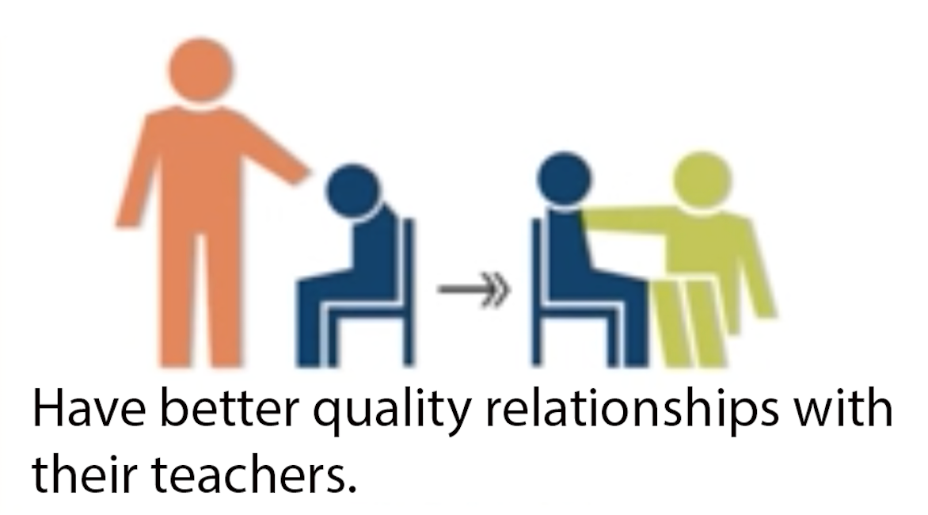
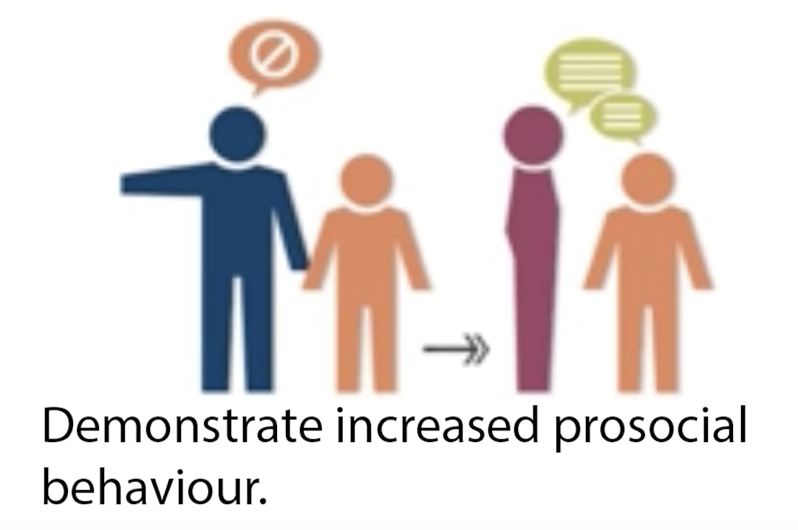
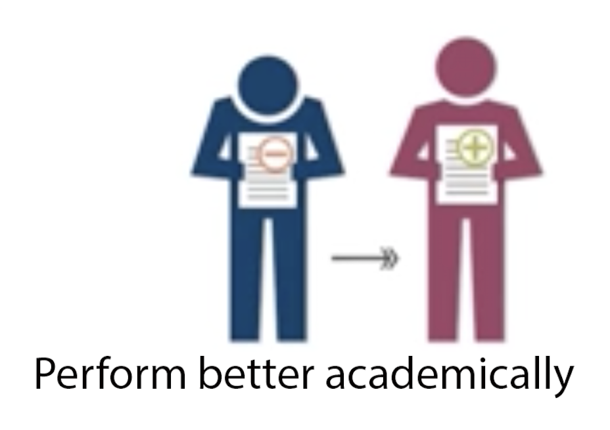
Class room

Slide 33
Is stress good or bad ?

Slide 34
There are two types of stresses
GOOD STRESS (Positive challenge) | BAD STRESS (No relief in sight)
Motivates us | Makes us physically sick
Promotes well-being | Weakens immunity
Enhances performance | Impairs performance

