Slide 1
Leadership and Management
Dr. kapila hettiarachchi
Mbbs. Md, mba (UK)
Lead Consultant Anaesthetist
Sirimavo Bandaranaike specialised children hospital
peradeniya

Slide 2
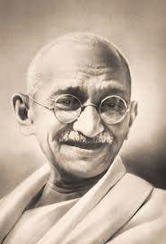
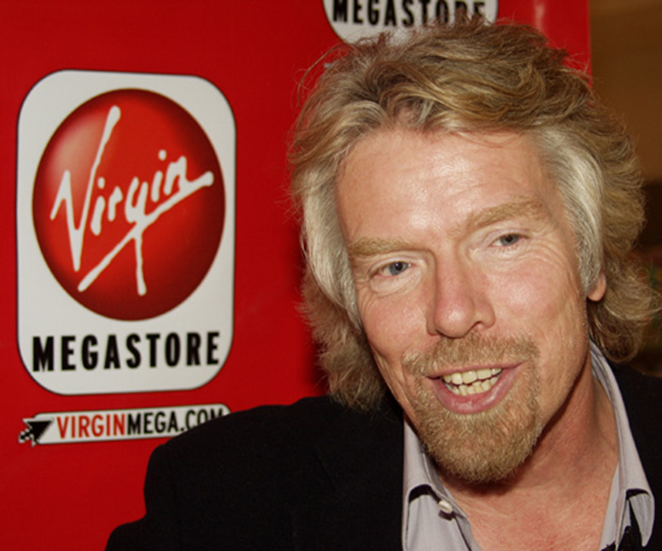
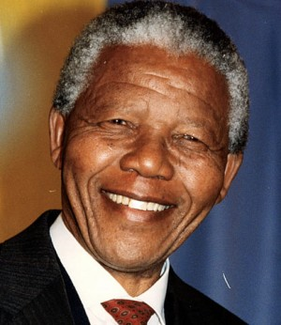
Are leaders born or made ?
Mahatma Gandhi
Mahatma Gandhi led India against the rule of the British.
He fought silently and practiced ahinsa or non-violence
Nelson Mandela was the leader and the face of the Anti- Apartheid movement
Richard Branson has one of the world's most widely recognized personal brands

Slide 3
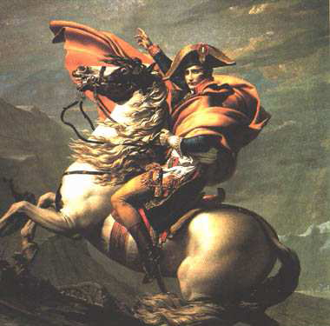
Great man theory
The leaders are born and not made and posses certain traits which were inherited
Great leaders can arise when there is a great need.
Assumptions

Slide 4
Trait Theory of Leadership
Based on the characteristics of many leaders - both successful and unsuccessful - and is used to predict leadership effectiveness.

Slide 5
Trait Theory of Leadership
Scholars taking the trait approach attempted to identify
Physiological (appearance, height, and weight),
Demographic (age, education and socioeconomic background)
Personality, (self-confidence, and aggressiveness),
Intellective (intelligence, decisiveness, judgment, and knowledge),
Task-related (achievement drive, initiative, and persistence), and
Social characteristics (sociability and cooperativeness) with leader emergence and leader effectiveness.

Slide 6
Leadership requires two types of skills
LEADERSHIP
Developing a direction and vision.
Making strategic decisions.
INTELLECTUAL SKILLS
Influencing others.
Interacting with peers, employees, clients, superiors
PEOPLE SKILLS

Slide 7
Do leaders need power ?

Slide 8
Five Bases of Power (French & Raven,1986)
Enable managers to be leaders and influence subordinates to achieve goals
Reward Power
Coercive Power
Expert Power
Legitimate Power
Referent Power
Source: Adapted from the “Bases of Social Power” by J. R French Jr. and B. Raven, 1962, in D. Cartwright (Ed.), Group Dynamics: Research and Theory (pp.259-269), New York: Harper & Row

Slide 9
Leaders can draw on four Sources of Power
POWER
Position Power
Authority
Centrality
control of rewards and punishment
Personal Power
Expertise
Charisma
Coercion
Resource & Information based Power
Knowledge
Coping with uncertainty
Linkages
Informal networks
Trade relations
Alliances

Slide 10
Leadership Styles
Broad classifications of leadership style include:
Authoritarian (or autocratic) style
Democratic style
Laissez-faire (genuine) style

Slide 11
Autocratic
The autocratic leadership style allows managers to make decisions alone without the input of others. Managers possess total authority and impose their will on employees. No one challenges the decisions of autocratic leaders.
Countries such as Cuba and North Korea operate under the autocratic leadership style.
This leadership style benefits employees who require close supervision.
Creative employees who thrive in group functions detest this leadership style.

Slide 12
Democratic
Manager allows the employees to take part in decision-making: therefore everything is agreed by the majority. (empowerment)
– ☺ this style can be particularly useful when complex decisions need to be made that require a range of specialist skills;
– ☺ job satisfaction and quality of work will improve.
– ☹ the decision-making process is severely slowed down, and the need of a consensus may avoid taking the 'best' decision for the business.

Slide 13
Laissez Faire
The absence of leadership
A hands-off, let-things-ride approach
Refers to a leader who:
abdicates responsibility
delays decisions
gives no feedback, and
makes little effort to help followers satisfy their needs

Slide 14
Transformational Leadership
“is a relationship of mutual stimulation and elevation that converts followers into moral agents”
(Burns, 1978)

Slide 15
Transactional vs. Transformational Leadership (Covey, 1972)
TRANSACTIONAL | TRANSFORMATIONAL
Task oriented | Relationship oriented
Discipline and incentives | Team building, motivation and collaboration
Focus on day to day activities | Focus on higher levels of success through participation and motivation
Supports structures and systems to support bottom line | Design and redesign job description to make them more meaningful and challenging

Slide 16
Transformational Leadership Concept
Leadership behaviours are on a continuum
Laissez Faire Transactional Transformational
Bass & Avolio, 1990

Slide 17
Cultural WEb

Slide 18
Cultural iceberg

