Slide 1
Paediatric anaesthesia
Dr. Kapila Hettiarachchi
Lead – Anaesthesia and SICU
SBSCH- Peradeniya

Slide 2
Paediatric anaesthesiology
Child is not a little adult

Slide 3
Heart rate
Age | Heart rate | SBP | Resp. rate
Newborn | 110-170 | >60 | 30-50
1 year | 100-160 | >80 | <40
5 year | 80-130 | >90 | <30
> 10 year | <90 | >90 | <20

Slide 4
Circulation
Stroke volume is fixed

Slide 5
Circulation
Cardiac Output = Stroke Volume X Heart Rate
CO depends on HR

Slide 6
Circulation
Blood Pressure = Stroke Volume X Heart Rate X Peripheral Vascular Resistance

Slide 7
Circulation
Hypoxia leads to bradycardia
Lack of tachycardia to hypovolemia/ Hypotension

Slide 8
Minute Ventilation = Tidal Volume X Resp. Rate
Tidal Volume is Fixed

Slide 9
Respiratory rate
Minute Ventilation depends on Respiratory Rate

Slide 10
Anatomically different

Slide 11
Airway Shape

Slide 12
ETT : sizes (pediartics)

Slide 13
Capnography
Use of capnography was mandated for all anesthesia procedures from moderate sedation to general anesthesia

Slide 14
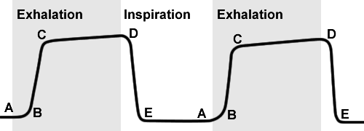
Capnography
Refers to the noninvasive measurement of the partial pressure of carbon dioxide in exhaled breath expressed as the CO₂ over time
Represented by waveform or capnogram
Four phases
Phase 1: beginning of exhalation
Phase 2: rise in CO₂ in the breath stream as it reaches the upper airway
Phase 3: Maximum CO₂ concentration at the end of the tidal breath
Phase 4: inspiratory cycle
Notes:
Phase 3: end-tidal CO2
Accurracy of EtCO2 to confirm tracheal location of an ETT is 100% sensitive and specific if patient not in cardiac arrest

Slide 15
Capnography

Slide 22
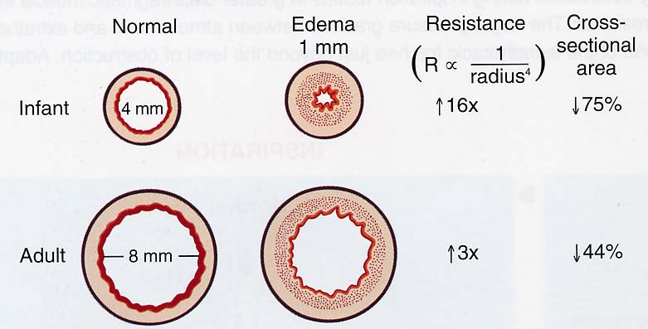
Hagen Poiseuille’s law

Slide 23
FRC –low
Hb P₅₀ - 19mmHg vs 26mmHg adults
Increased Oxygen consumption – 7ml/Kg/Min

Slide 24
Body Composition

Slide 25
Body fluid composition
ICF
ECF

Slide 26
Meticulous attention to fluid administration
Decreased glomerular filtration rate–
Decreased creatinine clearance–
Decreased sodium excretion–
Decreased glucose excretion–
Decreased bicarbonate resorption–
Decreased diluting capability–
Decreased concentrating ability

Slide 27
Maturation of renal function

Slide 28
What fluid to be given
Hypotonic solutions for maintenance + 10% dextrose
But Not N/5
Deficits – from Isotonic solutions
Hartmann’s solution is recommended

Slide 29
Intra operative fasting deficit correction
Simply administer 20-40 mL/Kg Hartmann’s solution
Other losses as usual

Slide 30
Updates
Weight (Kg) | Hourly |  | Daily
 | 4:2:1 rule after first 12 hours | 2:1:0.5 rule for first 12 hours | 4:2:1 rule after first 12 hours | 2:1:0.5 rule for first 12 hours
<10 | 4ml/Kg | 2ml/Kg | 100ml/Kg | 50ml/Kg
10-20 | 40ml+2ml/Kg For each Kg >10 | 20ml+1ml/Kg For each Kg >10 | 1000ml +50mL for each Kg >10 | 500ml+25mL for each Kg >10
>20 | 60ml+1ml/Kg For each Kg >20 | 30ml+0.5ml/Kg For each Kg >20 | 1500ml +20mL for each Kg >20 | 750ml +10mL for each Kg >20

Slide 31
All surgical patients
New recommendation
20-40mL/Kg Hartmann’s solution in first hour

Slide 32
Glucose management
High Glucose Utilisation
- Preterm – 5-6mg/kg/min
- Neonates 3-4mg/kg/min

Slide 33
Analgesia in children
Opioids
More potent in neonates than children or adults
Easier across Blood :Brain Barrier
Decreased metabolic capability
Increased sensitivity of respiratory centres

Slide 34
Caution in neonates
Hepatic conjugation is decreased
Cytochrome P450 pathways mature by 1 month
Renal clearance of morphine metabolites is decreased

Slide 36
Children
Have high rates of hepatic blood flow
Increased biotransformation and elimination

Slide 37
What is the dose ?

Slide 38
?

