Slide 1
Upper Airway management
Dr Kapila Hettiarachchi

Slide 2
Tripple mannouvor
Chin Lift
Jaw thrust
Head tilt

Slide 3
Chin lift & head tilt

Slide 4
Chin lift & head tilt

Slide 5
Chin lift & head tilt

Slide 6
Jaw thrust

Slide 7
Jaw thrust

Slide 8
Jaw thrust

Slide 9
Jaw thrust

Slide 10
Options to manage the airway
Simple airway adjuncts
Oropharyngeal airway
Nasopharyngeal airways
Bag-valve-mask (BVM) – ventilation
Laryngeal Mask Airway (LMA)
ET tube

Slide 11
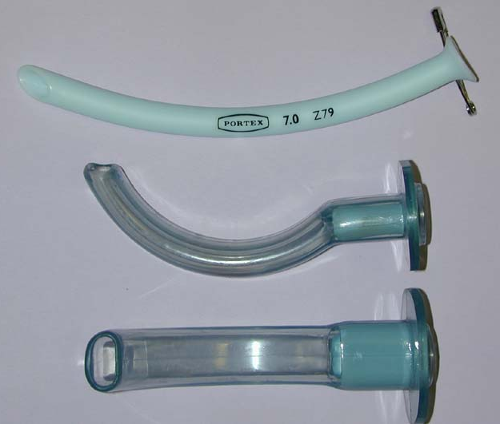
Simple airway adjuncts
Notes:
attempted in any unresponsive patient unresponsive patient without an intact gag an intact gag reflex to help maintain an open airway.
Do not force or blindly position an OPA as malposition can force the base of the tongue against the posterior pharyngeal wall, completely obstructing
the airway
MANUAL TECHNIQUES
Nasopharyngeal Airway (NPA) Also known as trumpets, NPAs are inserted through one nostril to create a passage between the nose and the nasopharynx.
Indications:
Alternative airway for patients with clenched jaw, in whom an OPA placement is not possible.
Patients who required airway assistance, but cannot tolerate an OPA.
To provide a portal for suctioning of secretions, blood,or other debris.

Slide 12
Rusch Color Coded Guedel Airways

Slide 13
Guedel pattern airway

Slide 14
Guedel pattern airway

Slide 15
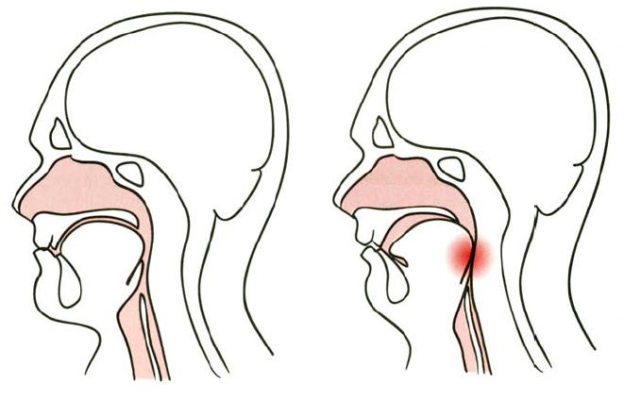
Airway obstruction
Notes:
Unconscious – loss of upper airway reflexes– tongue & epiglottis fall back against the posterior pharyngeal wall—

Slide 16
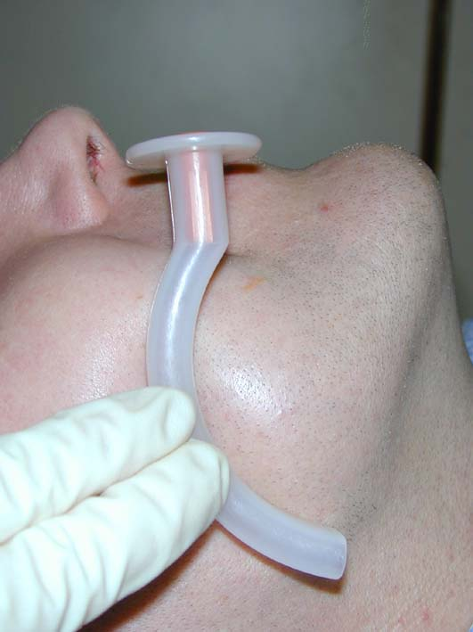
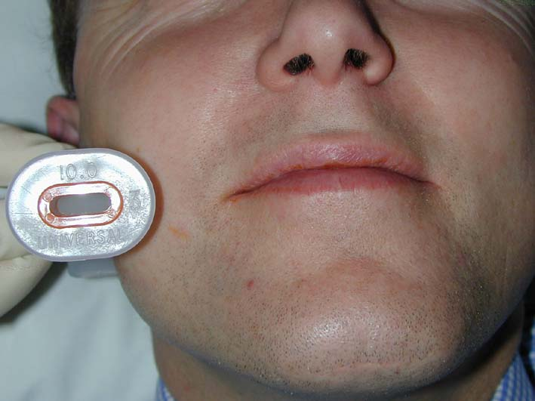
Sizing an oropharyngeal airway

Slide 18
Oropharyngeal airway insertion

Slide 19
Notes:
Artificial airway inserted via mouth or nose creates a air passage between the tongue & the posterior pharyngeal wall.

Slide 20
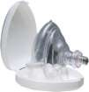
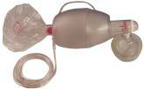
Mouth to Mask
BVM (Bag-valve-mask)
Ventilation
Notes:
A bag valve mask (also known as a BVM or Ambu bag) is a hand-held device used to provide positive pressure ventilation

Slide 21
The most important airway skill

Slide 22
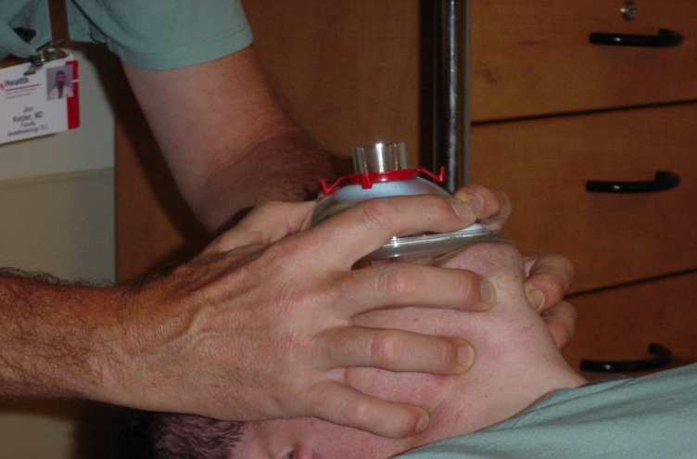
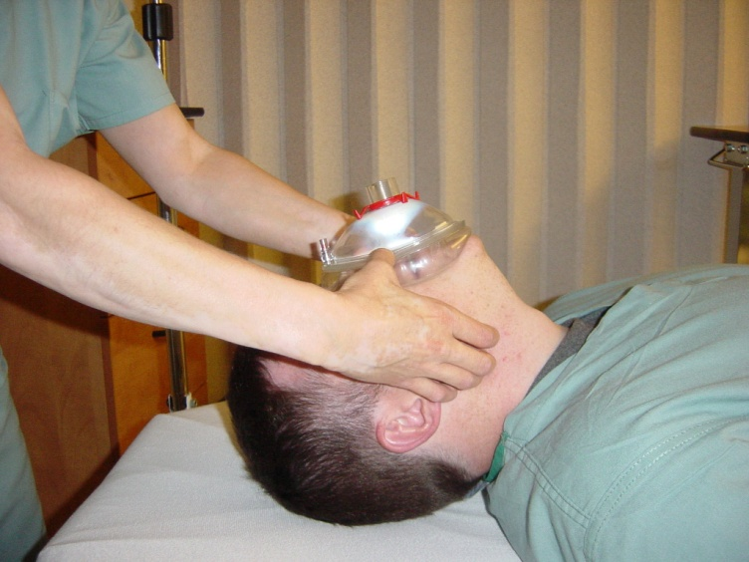
Mask Ventilation
Always the first response to inadequate oxygenation and ventilation
The first “bail-out” maneuver to a failed intubation attempt
Delay the urgency to intubate

Slide 23
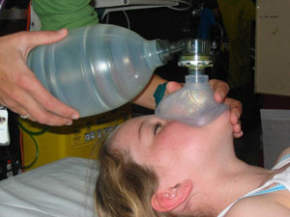
BVM Ventilation
Requires practice to master
One hand to
Maintain face seal
Position head
Maintain patency
Other hand ventilates

Slide 24
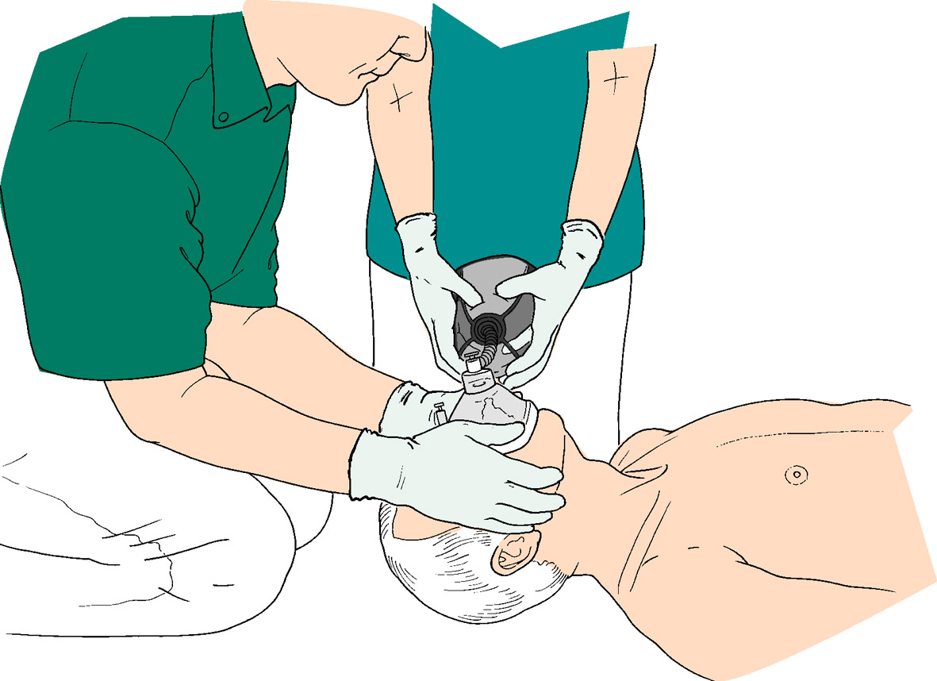
Bag-valve-mask, 2-person ventilation

Slide 25
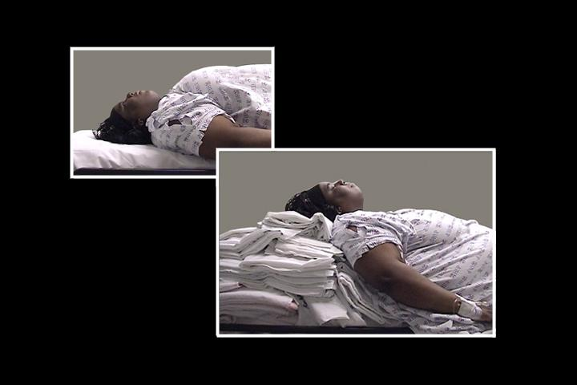
Sniffing the morning air!!
Notes:
Airway axises – neck flexed on chest and neck fully extended
oral, pharyngeal and laryngeal aligned.

Slide 26
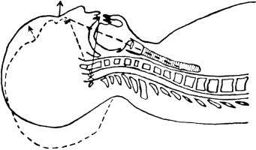
Sniffing Position
Align oral,
pharyngeal,
and laryngeal axes to
bring epiglottis and
vocal cords into view

Slide 27
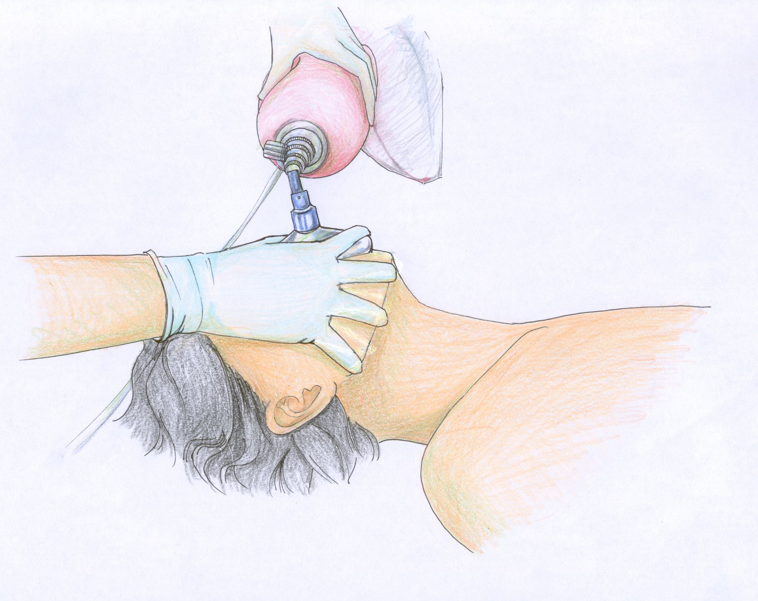

Slide 28
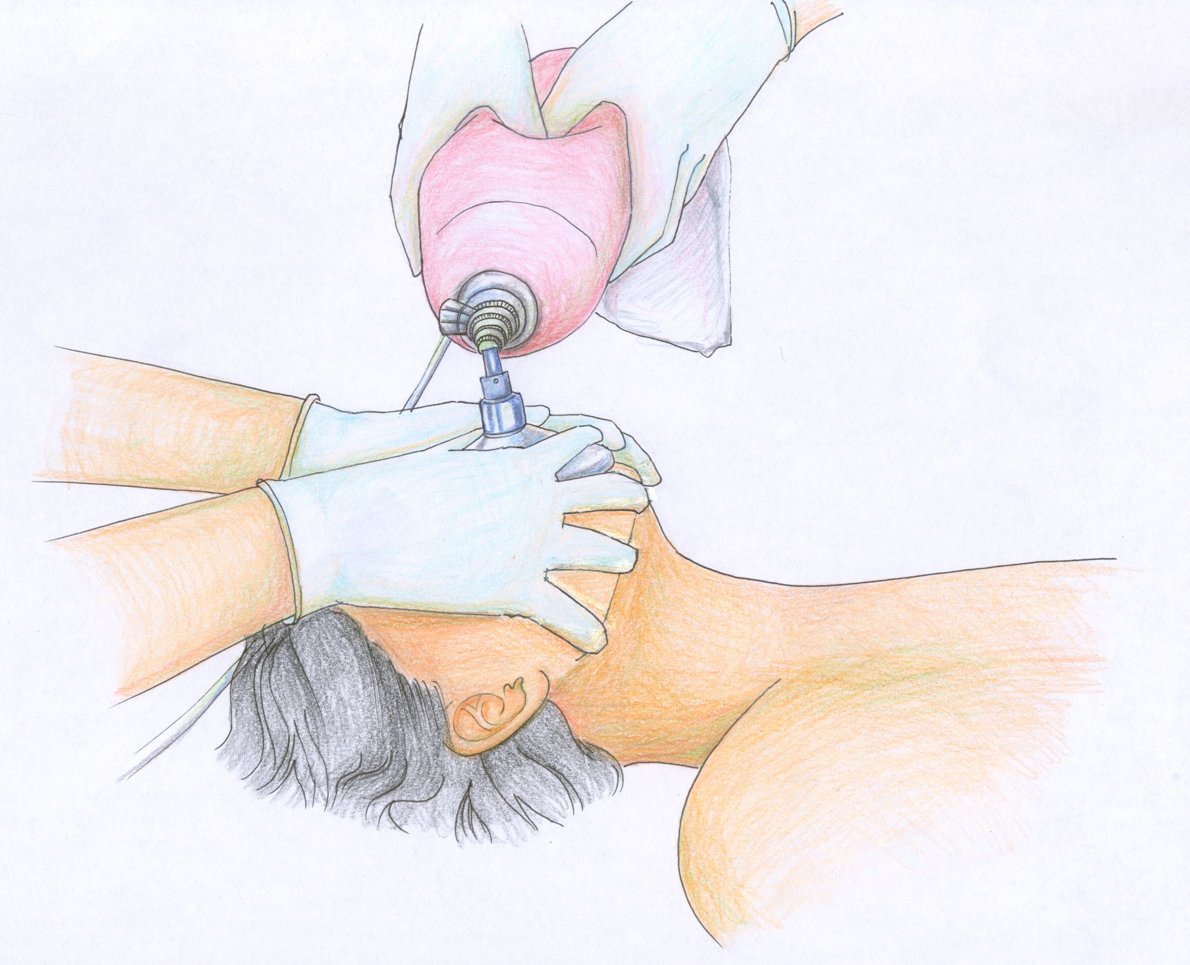

Slide 29
BVM Ventilation: Assessment of Efficacy
How do I know I am ventilating?
Observe the chest rise and fall
Good bilateral air entry
Lack of air entering the stomach
Feeling the bag
ETco2
Pulse oximetry

Slide 30
Laryngeal Mask Airway

Slide 31
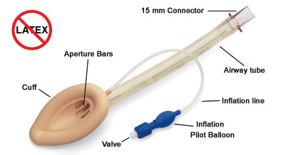

Slide 38
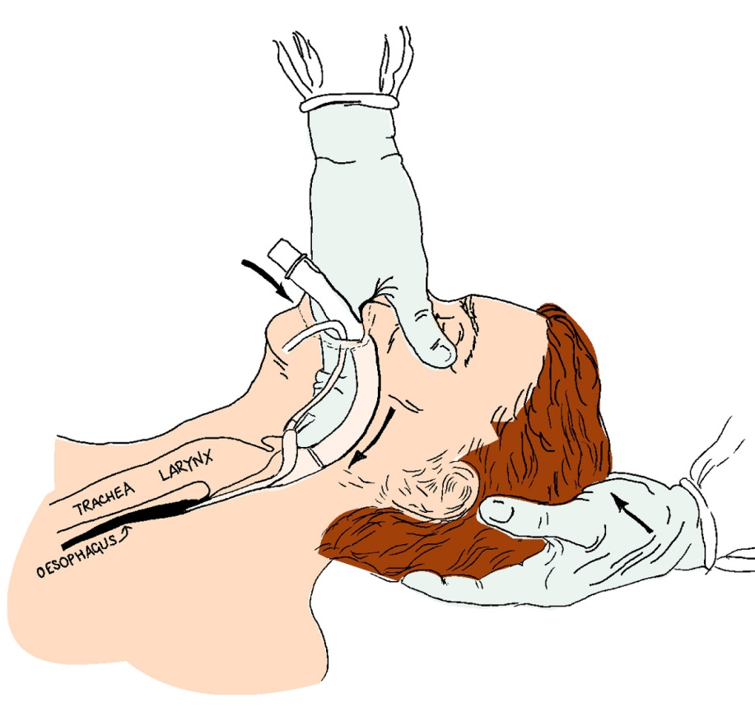
LMA Insertion
Notes:
Blindly inserted in to the hypopharynx 7 once inflated the cuff forms a low pressure seal around the entrance in to the larynx.

Slide 39
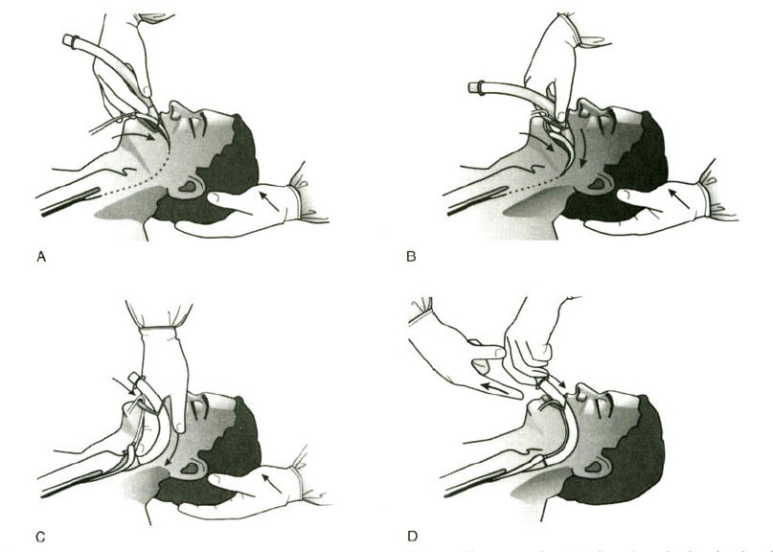
Laryngeal Mask Airway

Slide 40
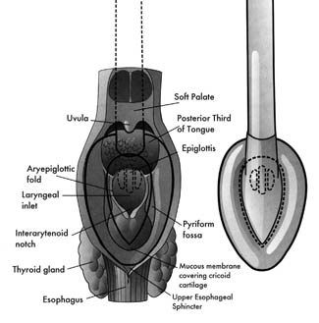
Laryngeal Mask Airway
Notes:
An ideally positioned cuff is bordered by the base of the tongue superiorly, the piriform sinusus laterally & the upper esopheagal sphincter inferiorly.

Slide 41
LMA Sizing
LMA Size | Patient Size
1 | Neonate / Infants < 5 kg
1 ½ | Infants 5-10 kg
2 | Infants / Children 10-20 kg
2 ½ | Children 20-30 kg
3 | Children/Small adults 30-50 kg
4 | Adults 50-70 kg
5 | Large adult >70 kg

Slide 42
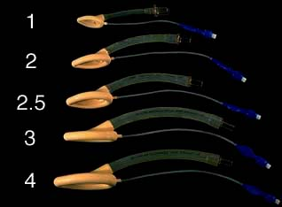

Slide 43
Advantages of Using LMA
Leaves provider’s hands free
Patient can produce effective cough
Allows spontaneous ventilation
Malposition even can adequately ventilate
Sore Throat- less than ETT
Better tolerated than ETT
Better than Face Mask
Minimal Cardiovascular Response
Notes:
43
Sore Throat- less than ETT and FM
Leaves Provider’s Hands Free
Better tolerated than ETT
Better than Face Mask
even malpositioned, can still usually ventilate
Pt can produce effective cough even w/ LMA in place
allows spontaneous ventilation
Minimal CV Response- probably due to lack of direct laryngeal and tracheal stimulation

Slide 44
Disadvantages of LMA over ETT
Lower seal pressure
Higher frequency of gastric insufflation
Increased Aspiration risk
Notes:
44

Slide 45
Endotracheal
intubation

Slide 46
Indications for endotracheal intubation
Provides relatively better protection against pulmonary aspiration
Maintains a patent conduit for respiratory gas exchange
Provides a means for coupling the lungs to mechanical ventilators
Establishes a route for clearance of secretions
Provides a route for drug administration

Slide 47
Equipment
Laryngoscope
Tubes
Oxygen source
Bag & Mask
Suction
Lubricant
Forceps (Magill)
Adhesive tape
Stylet
Syringe

Slide 48
Stainless Laryngoscope Blades

Slide 49
Tracheal Tube

Slide 50
ETT : sizes (Pediartics)

Slide 51
Anticipate the difficulties
Identify in advance the patient with anatomical difficulty
Have sufficient skill and training
Have a preformulated plan for potential disaster

Slide 52
What do we do when we have a difficult airway ?

Slide 53
Be prepared
Do we have all the help we need,
all Airway equipment with us?
(Suction?)
Competence with all equipment
Working equipment
Be prepared for surgical management
Master the art of bagging
Have at least one, if not two, working IV lines

Slide 54
Equipment
Suction, Oxygen
Laryngoscope, ET Tubes, Stylet
BVM
Monitoring equipment
Continuous cardiac monitoring
Pulse oximeter (continuous)
Auto BP (ideal)
CO₂ device (ET confirmation device)
Pharmacologic agents, mixed and ready

Slide 55
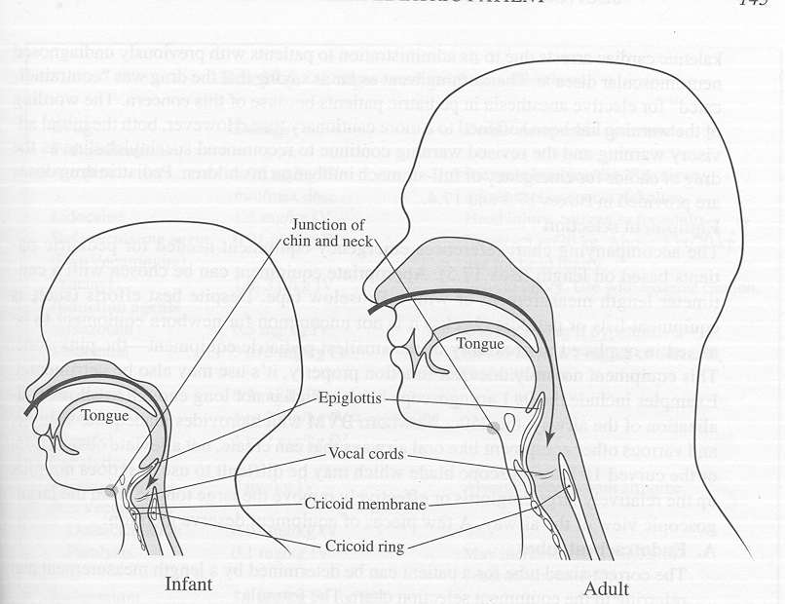
Airway differences

Slide 56
Airway Shape

Slide 57
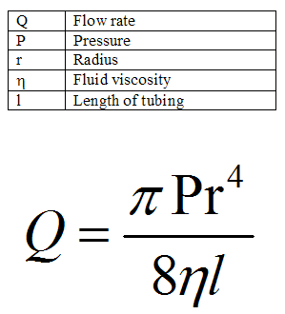
Effect Of Edema

Slide 58
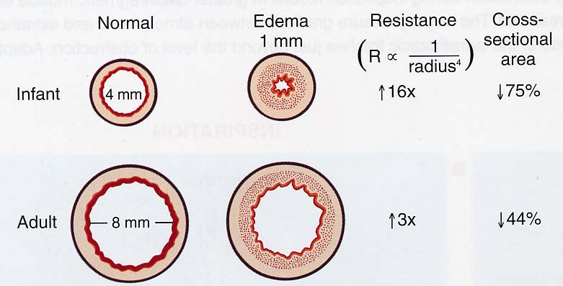
Effect Of Edema

Slide 59
Technique of Laryngoscopy
“Sniffing” position to align oral-pharyngeal-laryngeal axis
Flex neck by placing pillow beneath occiput (raise 10 cm)
Extend head maximally
With laryngoscope
open mouth fully
push tongue to left out of view
pull upward at 45 degrees

Slide 60
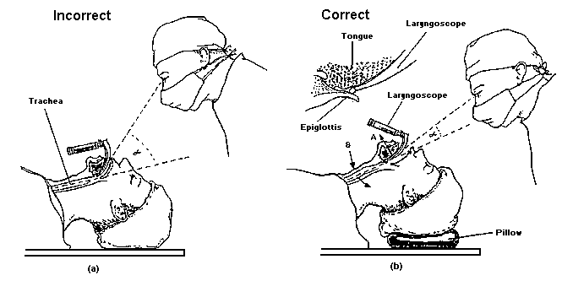
Correct Placement for intubation (b)

Slide 61
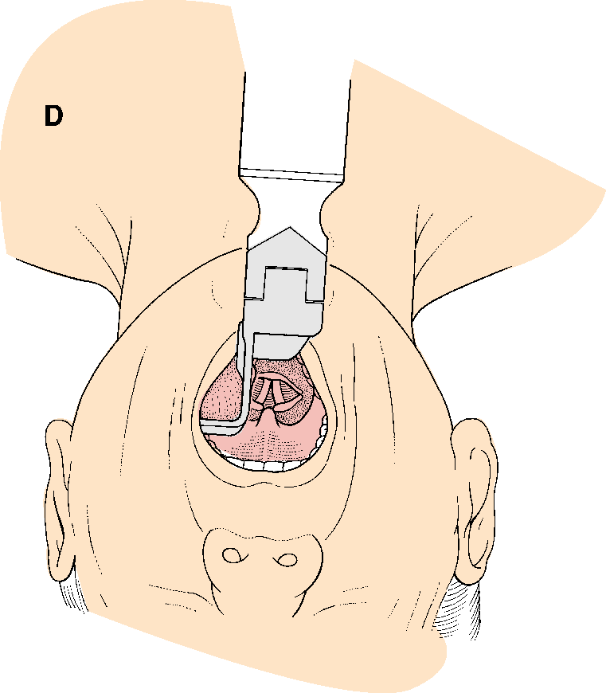
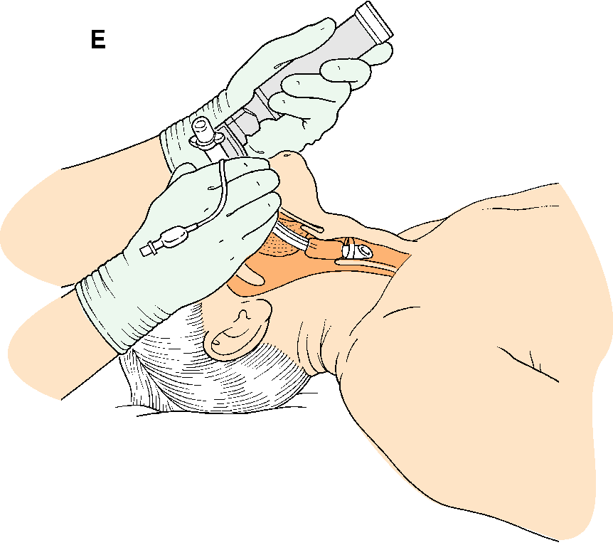
Insertion of tracheal tube

Slide 62
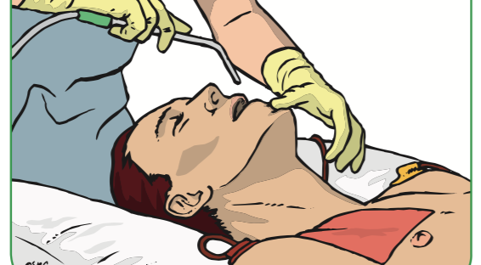
Suction

Slide 63
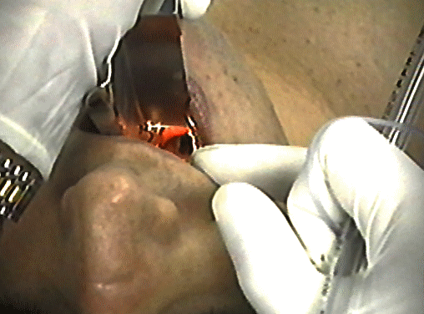
Airway Management

Slide 64
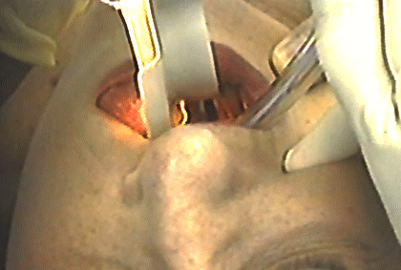
Airway Management

Slide 65
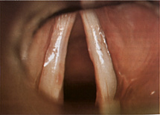
Airway Management

Slide 66
Confirmation of ETT Placement: Clinical Evaluation
Observation of ETT placing through cords
Clear, equal breath sounds bilaterally
Absence of breath sounds over epigastrium
Symmetrical rising of chest
Condensation or “fogging” of ETT
ET co2
ALL SUBJECT TO FAILURE
Pulse oximetry is LATE indicator

Slide 67
Confirmation of ETT Placement
Placement of ETT in the esophagus is an accepted complication of intubation
However, failure to recognize and correct esophageal intubation immediately IS NOT ACCEPTABLE
ETCO₂ detection should be used on every emergency intubation

Slide 68
Summery
Options to manage the airway
Simple airway adjuncts
oropharyngeal airway
Nasopharyngeal airways
Mouth to mask ventilation
Bag-valve-mask – ventilation (BVM)
Laryngeal Mask Airway (LMA)
ET tube

